Slide 1

Executive Summary
User Persona
Consumer Journey
Industry Insights
Recommendations
Financial Projection
Implementation Plan
The focus will be on redefining the credit card engagement with gamification, personalization & profitability to outpace competition
1
Problem Statement
Problem
Competitors have launched credit cards with new offerings that are quickly taking away our market share
Objective
2
Objective
Define features for a new credit card and design a plan to increase market share
Executive Summary
3
Solution
Solution
Credit Card focused on middle aged high-income professionals with gamified rewards and personalized support
4
Impact
Impact
Estimated to have 1 lakh+ cards in circulation and over 20 crore+ EBIDTA by year 7
Risks
5
Risks
Opportunity cost of Investing resources in a new credit card instead of testing other growing digital payment avenues

Slide 2



Executive Summary
User Persona
Consumer Journey
Industry Insights
Recommendations
Financial Projection
Implementation Plan
Based on 280+ credit card users, 3 typical consumer profiles are defined and high income professionals have been identified as the key growth segment
Focus Group
Importance of Features
High Income
Professional
Mid Spend
Entrepreneurs
Value Oriented Professionals
Rewards
Income: > Rs2 lakh
Spend: 1 lakh – 2 lakh
Mostly spends on Travel and Online Shopping
Income: Rs 1 lakh – 2 lakh
Spend: Rs 1 lakh – 2lakh
Mostly spends on Travel, dining and food delivery
Income: Rs 1 lakh – 2 lakh
Spend: Rs 50,000 -1 lakh
Mostly spends on online shopping and EMI purchases
Fees
Characteristics
Brand Trust
Lounge Access
Pain Points
No control over rewards and transaction being declined without clear reason
Difficult reward redemption process
Slow Onboarding and high interest charges on late payments
International Usage
EMI Option
Fuel Waiver
Cobranded Benefits
International Usage
Lounge Access
Fuel Waiver
EMI Options
Customer Service
Lounge Access
Low Fees
Customer Service
Key
Features
Co-Branded Benefits
Card with customizable reward with different brands allowing to switch benefits from travel to shopping
Card with offers on restaurants and food providing instant cashback compared to accumulated rewards
Low fees card with potentially less rewards but better customer service and EMI benefits
Credit Limit
Potential
Card
Customer Service
Notes:
User Persona

Slide 3
Executive Summary
User Persona
Consumer Journey
Industry Insights
Recommendations
Financial Projection
Implementation Plan
Consumer Journey indicates there is scope to improve onboarding process and a need to make credit card research easier for consumer
Researching
Comparing
Application
Onboarding
Payment
Support
Rewards
Looking for credit card options based on needs and lifestyle
Shortlisting cards based on features, fees, and offers
Filling out application form, KYC, uploading documents
Receiving card, activating it, setting PIN, learning app
Making purchases, paying bills, viewing statements
Contacting bank for queries, blocking card, or complaints
Checking points, accessing rewards, redeeming offers
Actions
Satisfaction
Search engines, influencers, Instagram/ YouTube, Friends/Family
Comparison websites, bank websites, YouTube reviews
Bank apps/websites, physical branches, telecallers
Mobile app, welcome kit, SMS/email instructions
Mobile app, autopay, email reminders, billers
Call center, chatbot, mobile app, branch visit
Mobile app, partner websites, customer support
Touchpoint
Overwhelming options, lack of clarity, biased info
Hidden charges, difficult comparisons, non-standard formats
Complex process, KYC failures, unclear documentation needs
Delayed delivery, confusing activation, poor onboarding UX
Interest charges confusion, missed due dates, UX issues
Long wait times, poor issue resolution, lack of follow-up
Complicated redemption rules, limited catalog, expiration of points
Painpoints
Notes:
Consumer Journey

Slide 4
Executive Summary
User Persona
Consumer Journey
Industry Insights
Recommendations
Financial Projection
Implementation Plan
Credit card market is still underpenetrated and will see steady growth in India but with significant risk from substitutes like UPI Payments
What are the major Growth Drivers for Credit Cards?
Market share by Credit Card Issuers
Rising Consumer Spending and E-commerce Growth
As disposable incomes rise, especially in emerging markets, credit card usage for online shopping and subscriptions will increase with more penetration in new segments
Credit Awareness and Credit Score Building
Growing understanding of the importance of credit scores (CIBIL, Experian) is encouraging young users to adopt credit cards
BNPL and shifting consumer mindset
Millennials and Gen Z prefer flexible, short-term credit — credit cards with EMI options or linked BNPL services bridge this demand.
Number of Credit Cards Issued
Opportunities
Steady growth anticipated but at a conservative rate accounting for surge of UPI in India
Shift from cash to digital payment adoption
Increasing need of personalization and niche cards with premium offerings
Threats
Rising competition from UPI and other BNPL products
Interchange Fee pressure from merchants and regulators
Notes:
Industry Insights

Slide 5

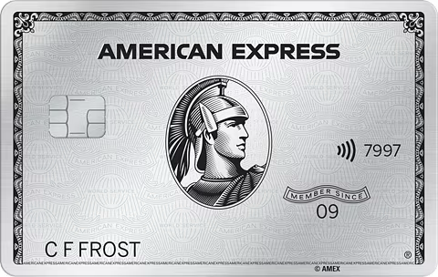
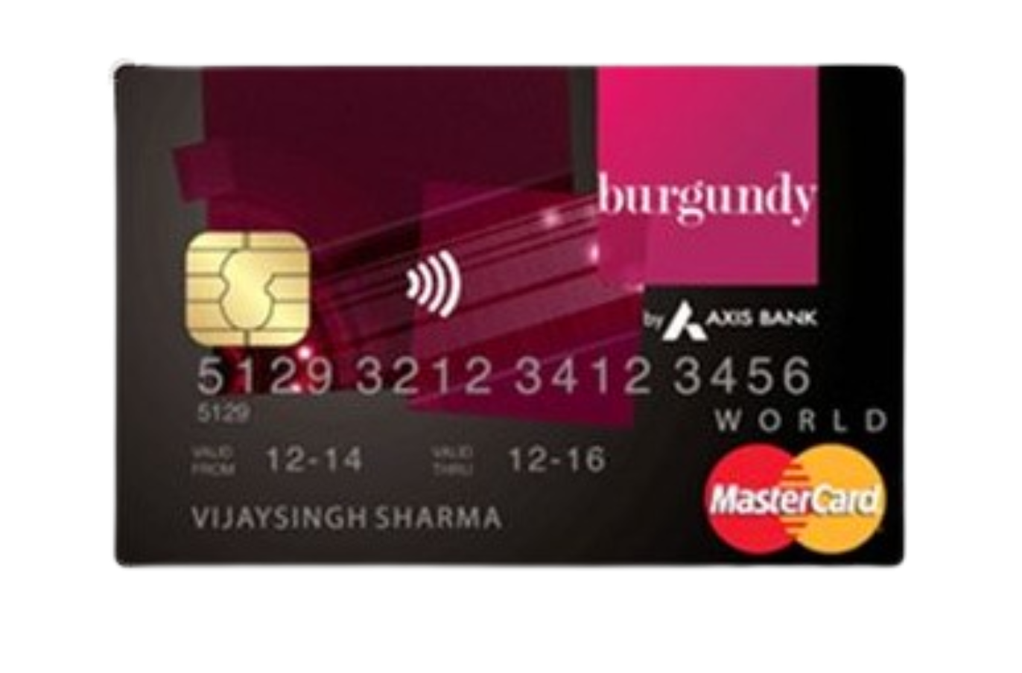
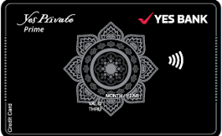

Executive Summary
User Persona
Consumer Journey
Industry Insights
Recommendations
Financial Projection
Implementation Plan
Analyzed the premium cards in the market to benchmark and understand the best practices in the industry
HDFC Diners
American Express Platina
Yes Private
ICICI Emerald
Axis Bank Burgundy
Rewards
High
High
Medium
Medium
High
Great rewards on travel & dining
Premium rewards
Decent rewards on select spends
Reward rate is average
Strong reward program for HNIs
Acceptance
High
Medium
High
High
High
Widely accepted globally
Limited acceptance
outside major cities
Mastercard/Visa network support
Excellent acceptance
across platforms
Globally accepted
Annual Fees
Medium
Low
High
High
Low
₹10,000 (waived on spend)
₹60,000/year, non-waivable
Nominal fees with spend waiver
Free for Burgundy clients
Premium pricing for elite clientele
Travel Benefits
High
High
Medium
Medium
High
Lounge access + concierge
Global lounges, hotel perks
Access to select lounges
Decent travel support
Access to top-tier lounges globally
Foreign Benefits
Medium
High
Medium
Medium
High
Forex markup ~2%
0% forex markup, strong
global benefits
2% forex, some overseas perks
Moderate forex charges
Forex markup waived,
luxury perks abroad
Notes:
Industry Insights

Slide 6













Executive Summary
User Persona
Consumer Journey
Industry Insights
Recommendations
Financial Projection
Implementation Plan
Multiple initiatives are identified and would focus on the most feasible solutions that have potential to provide maximum benefit to consumers
High
Least Priority
Second Priority
First Priority
High
Gamified Rewards
Hyper Personalized Reward Engine
Global Lounge with guest passes
Travel Fasttrack across major airports
Spend Analytics
Personalized Support
Benefit to Consumers
Premium Experience Day Invite
Power Rewards
Community Co-Creation
Impact Rewards
Alternative Use Cards
Customizable card design
Credit Score Trainer
Low
Feasibility and Ease of Implementation
12
Low
Notes:
Recommendations

Slide 7
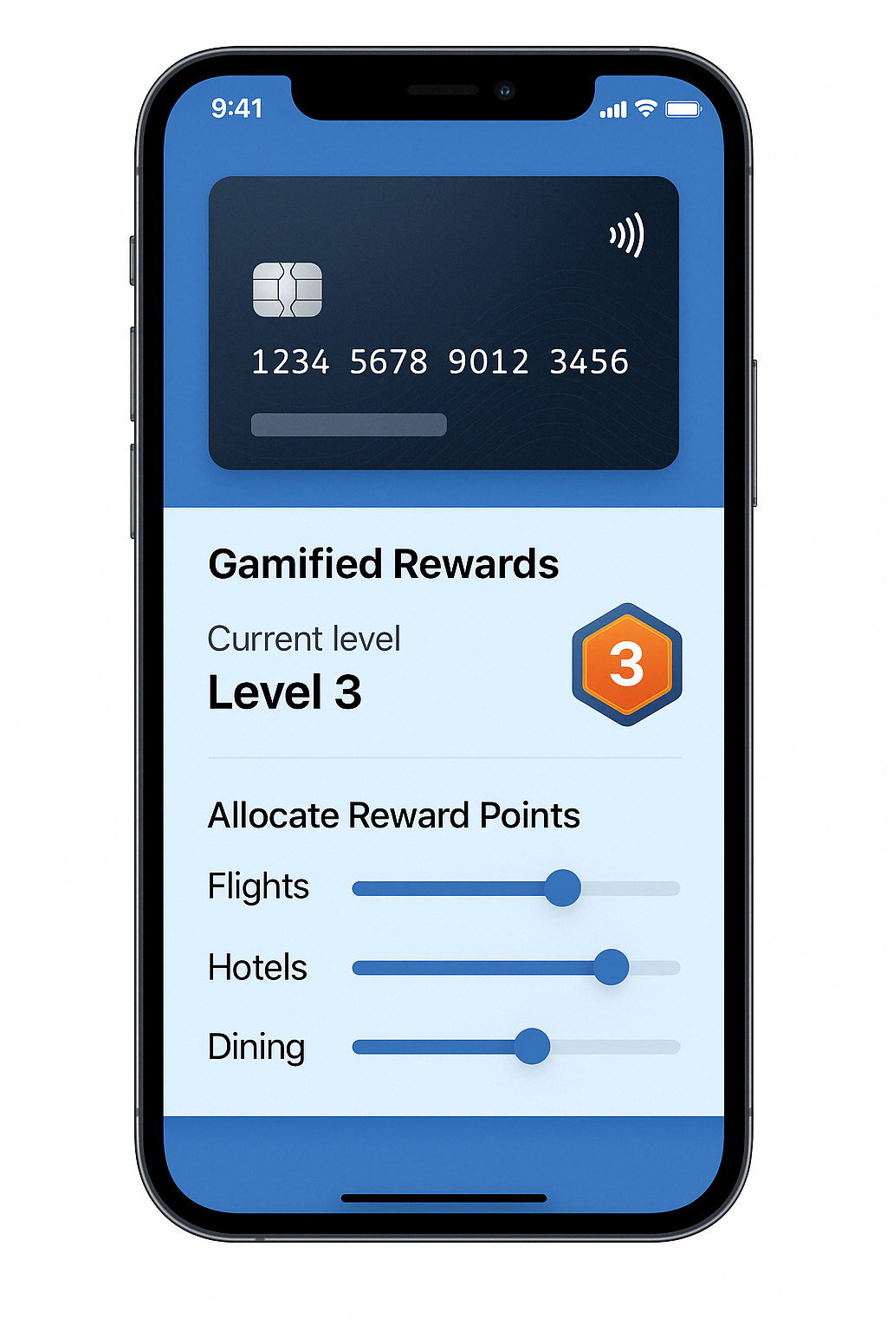
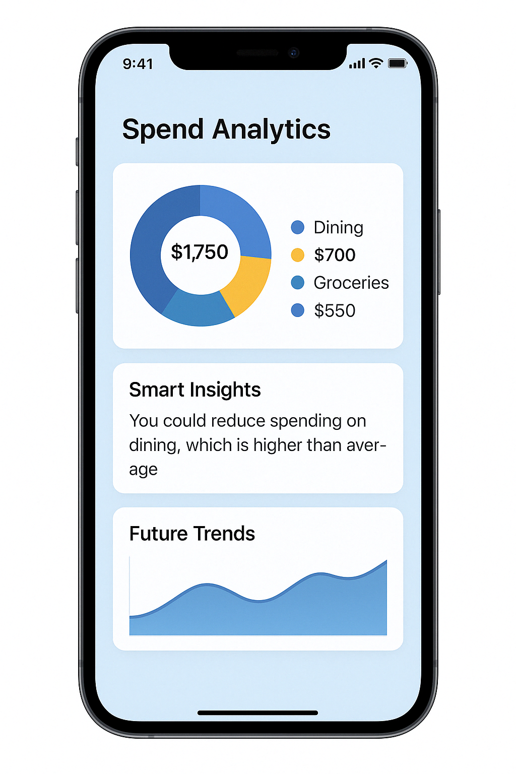
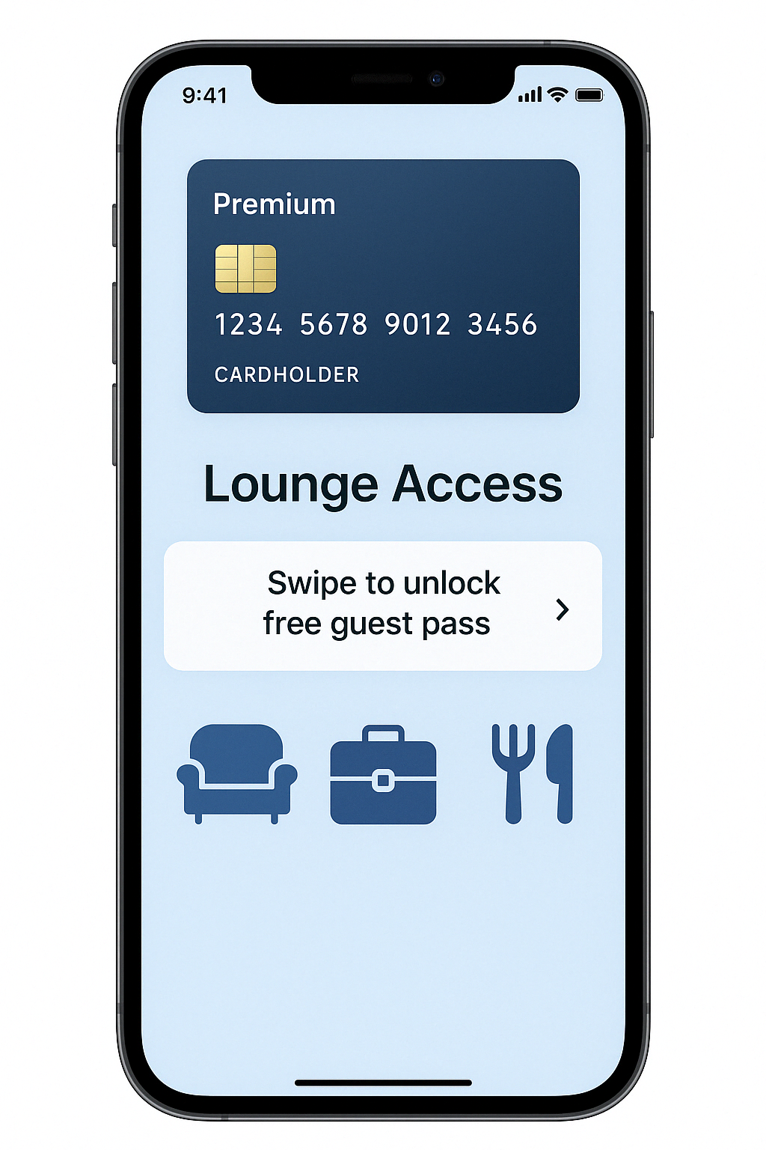
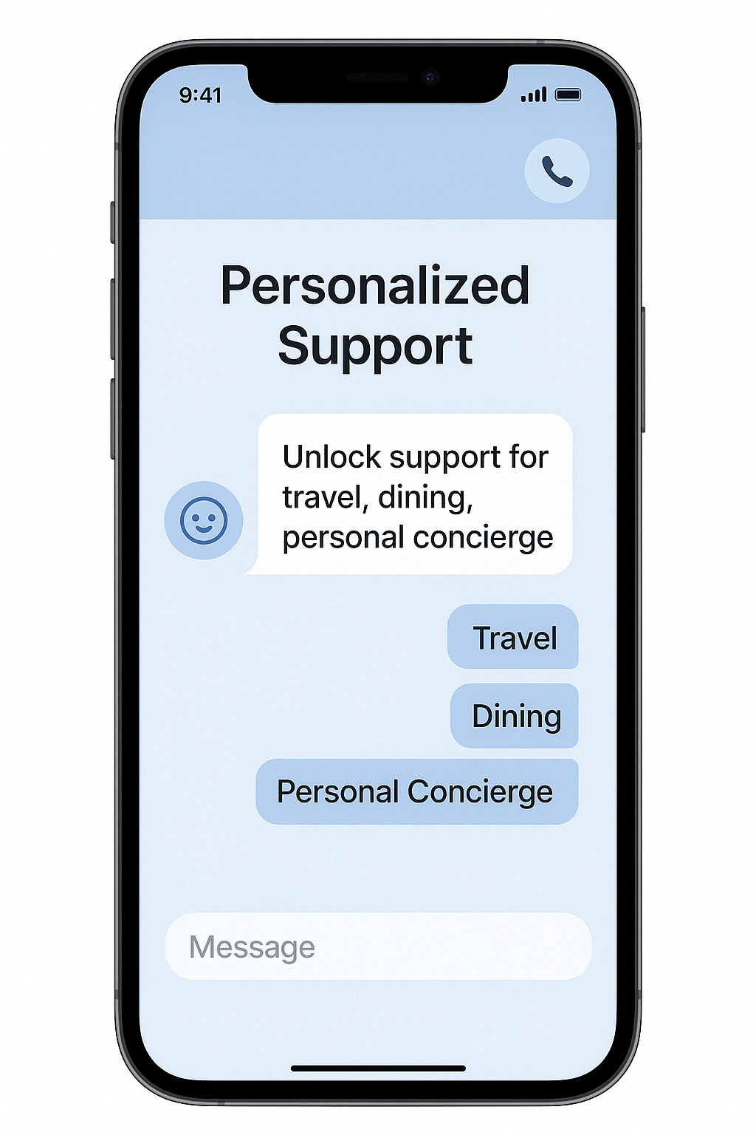
Executive Summary
User Persona
Consumer Journey
Industry Insights
Recommendations
Financial Projection
Implementation Plan
Based on the needs analysis, 4 key features are identified for the high-income professionals that will help acquire and retain users
Gamified Rewards
Spend Analytics
1
Gamified Rewards to feel involved in the reward collection process
Split your reward points collection across categories. More reward points on flights this month instead of hotels? Switch the allocation!
Earn badges and loyalty points to unlock better rewards as you level up!
2
Spend Analytics to always stay on top of your finance
Explore spend analytics and avail invoices of all your spends in a dashboard for easy download (receipt submission at office is easier than before!)
Recommendations on spend insights to improve your budgeting and forecast upcoming expenses
Global Lounge Pass with Free Guest
Personalized Support
3
Global Lounge Access with 1 free pass every quarter to make travel hassle free!
3 international lounge access with 1 free pass every quarter to make international travel easier
Enjoy premium lounge services on higher spending
4
Personalized Support and concierge services
24/7 personalized support to make your bookings and travel easy
Avail concierge services at major airports and selected hotels
Notes:
Recommendations

Slide 8


Executive Summary
User Persona
Consumer Journey
Industry Insights
Recommendations
Financial Projection
Implementation Plan
Hyper targeted outreach, exclusive offers for acquisition and a personalized reward system will allow a steady user funnel
AWARENESS STRATEGY
Hyper targeted digital outreach: Meta ads and collaboration with travel & finance influencer
Articles and advertorials in top business publications, luxury magazines, and high‑traffic financial news sites.
ACQUISTIION STRATEGY
Awareness
Co-branded Partner Offers: Exclusive signups with partner airlines/hotels
Limited “Founding Member” invite system where existing cardholders earn elite rewards for every successful referral.
Acquisition
RETENTION STRATEGY
Retention
Tiered Milestone benefits after crossing spending thresholds
Invite‑only events, partner pop‑ups, or limited‑edition offers that only active users can access.

Slide 9
Executive Summary
User Persona
Consumer Journey
Industry Insights
Recommendations
Financial Projection
Implementation Plan
Expected to have 100k+ cards in circulation and reach an EBIDTA of 20 crore+ by year 7
Total Revenue
NPV
Total Cost
Payback Period
99.6 cr
9.8 cr
73.5 cr
5- 6 years
IRR
7 years cumulative
7 years period
7 years Cumulative
28%
ROI
36%
 | Year 1 | Year 2 | Year 3 | Year 4 | Year 5 | Year 6 | Year 7
Revenue | ₹ 61,21,600.00 | ₹ 1,28,55,360.00 | ₹ 2,69,96,256.00 | ₹ 5,66,92,137.60 | ₹ 11,90,53,488.96 | ₹ 25,00,12,326.82 | ₹ 52,50,25,886.31
Cost | ₹ 1,70,96,000.00 | ₹ 2,24,61,600.00 | ₹ 3,49,83,360.00 | ₹ 5,56,54,056.00 | ₹ 9,11,34,417.60 | ₹ 15,98,84,130.96 | ₹ 30,43,76,772.82
EBIDTA | -₹ 1,09,74,400.00 | -₹ 96,06,240.00 | -₹ 79,87,104.00 | ₹ 10,38,081.60 | ₹ 2,79,19,071.36 | ₹ 9,01,28,195.86 | ₹ 22,06,49,113.50
Notes:
Financials

Slide 10

Executive Summary
User Persona
Consumer Journey
Industry Insights
Recommendations
Financial Projection
Implementation Plan
A 12-month detailed plan has been laid out with a clear emphasis on the key tasks to ensure seamless operations till launch
12- Month Execution Plan
Month 1
Month 2
Month 3
Month 4
Month 5
Month 6
Month 7
Month 8
Month 9
Month 10
Month 11
Month 12
Product Finalization
Card design, Tech Architecture
Design & Development
Application, Analytics, Backend APIs, Beta App
Gamified Rewards MVP
Badge System Setup, Levels and Reward Redemption Flows
Personalized Support Setup
Onboarding premium support team
Integrating Partners
Negotiation, defining SLAs
Power Rewards Campaign
Features and offers
Travel Fast-Track Roll out
Tie Up with Concierge & Airport Services
Marketing Pre Launch
Communication channels, positioning, influencer tie-ups, launch events
Continuous Initiatives (i.e., not dependent on timelines)
Regulatory compliances from SEBI, RBI and other related administrative bodies
Hiring and strategy roadmap for the next 10 years
Partnerships with airports, reward partners, PSPs, card network etc.
Legend
Periodic Process
Permanent addition to service catalogue
15
Notes:
Implementation Plan

Slide 11
TEAM DETAILS

